Slide 1

Library Management System
Presented by:
17sw27,17sw113,17sw37

Slide 2
Library Management System
Objective
The objective of this system is to develop a computerized system to maintain all the daily work of the library.
Modules
Divided into two modules
Admin
Student

Slide 3
Library Management System
Admin Features
Admin can add / delete /search books
Admin can issue a new book to student and also update the details
when student return book
Admin can search student by using their username
Admin can also view student details
Admin can reply in the comment box.

Slide 4
Library Management System
Student Features
Student can register and after registration they will get student-id
They can search for a book by book name
Student can request for a book.
After the admin approve the request they can see the issue and return date.
Also, there is a public comment section where registered users can comment on their suggestions and can ask questions.

Slide 5
Library Management System
Technologies used
HTML: Page layout
CSS: Designing and Styling
Java Script: Frontend-Give webpages interactive elements to engage a user.
PHP: Backend
MySQl:Database
Bootstrap

Slide 6

Home Page

Slide 7
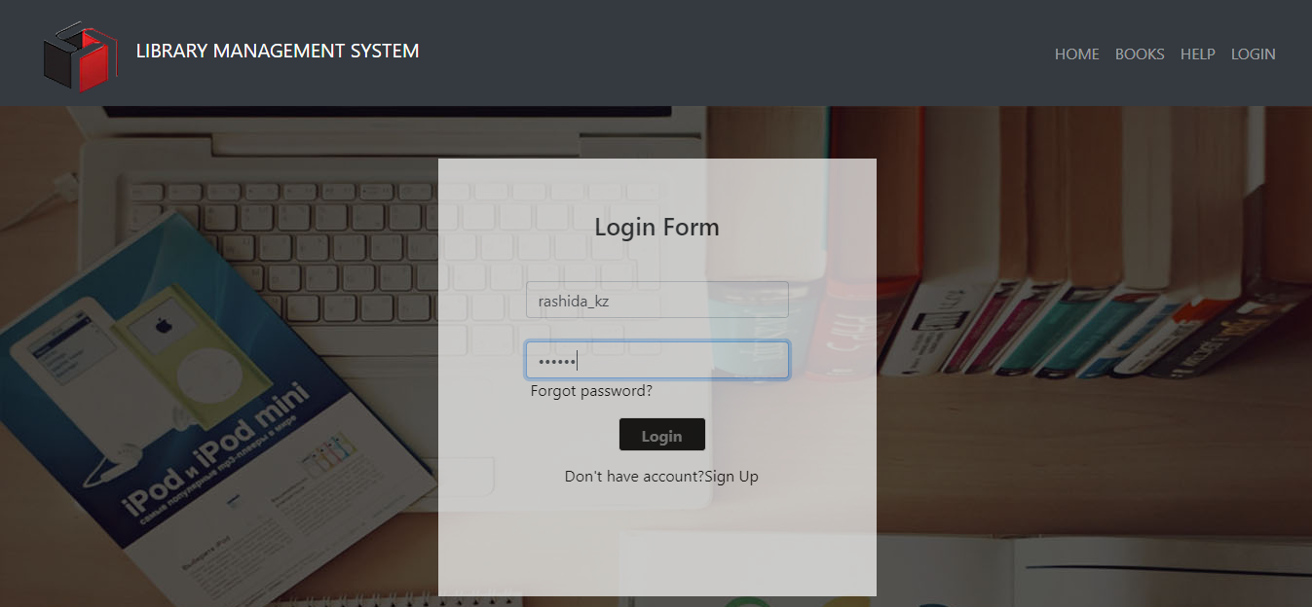
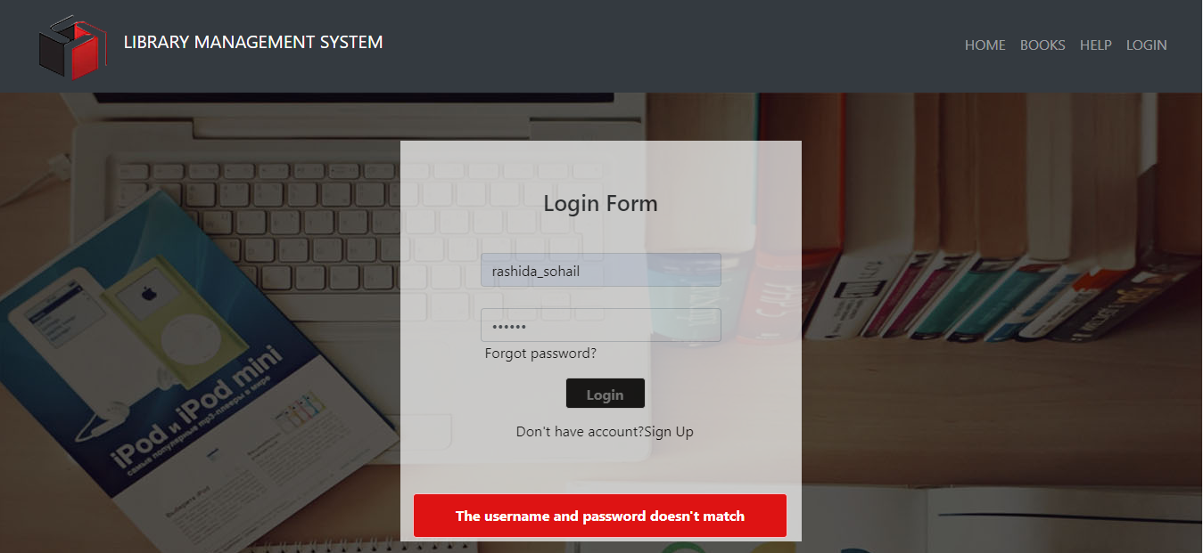
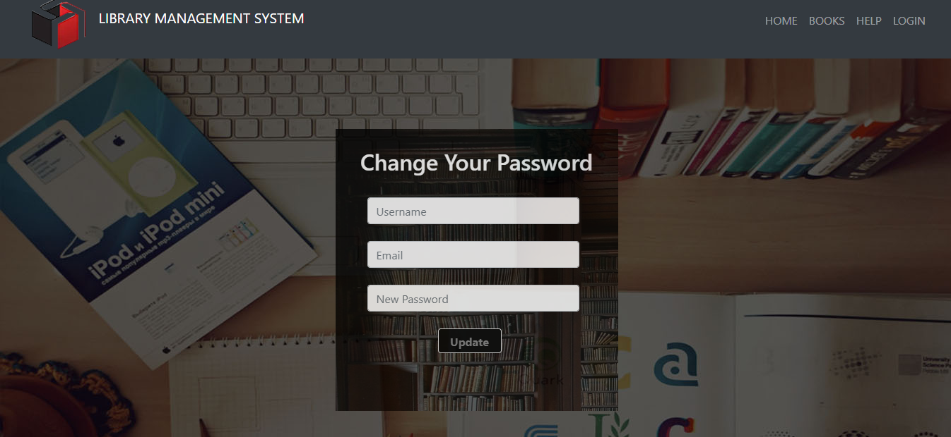
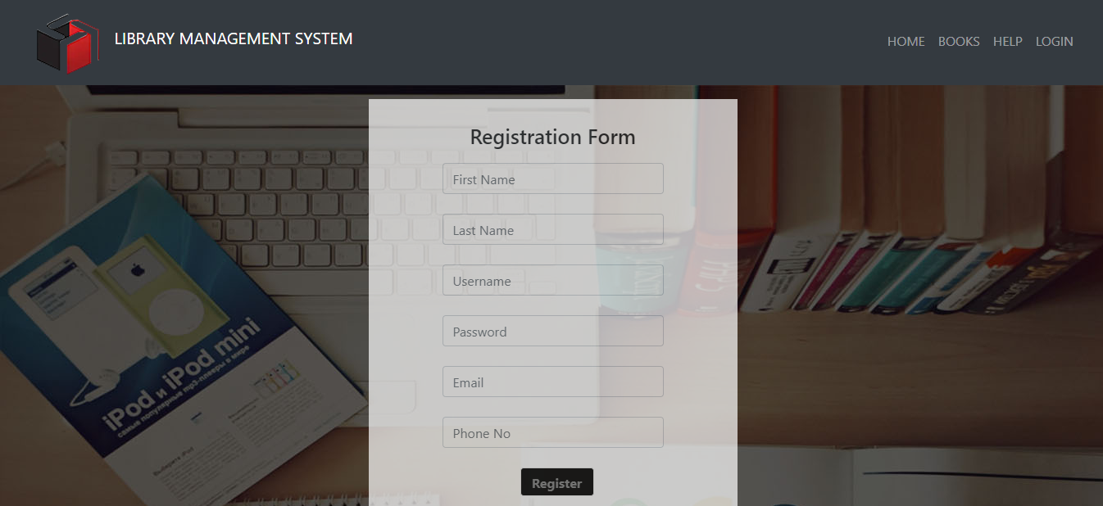
Admin Login/ Sign Up
Login
Wrong username/password
Forgot Password
Registration

Slide 8
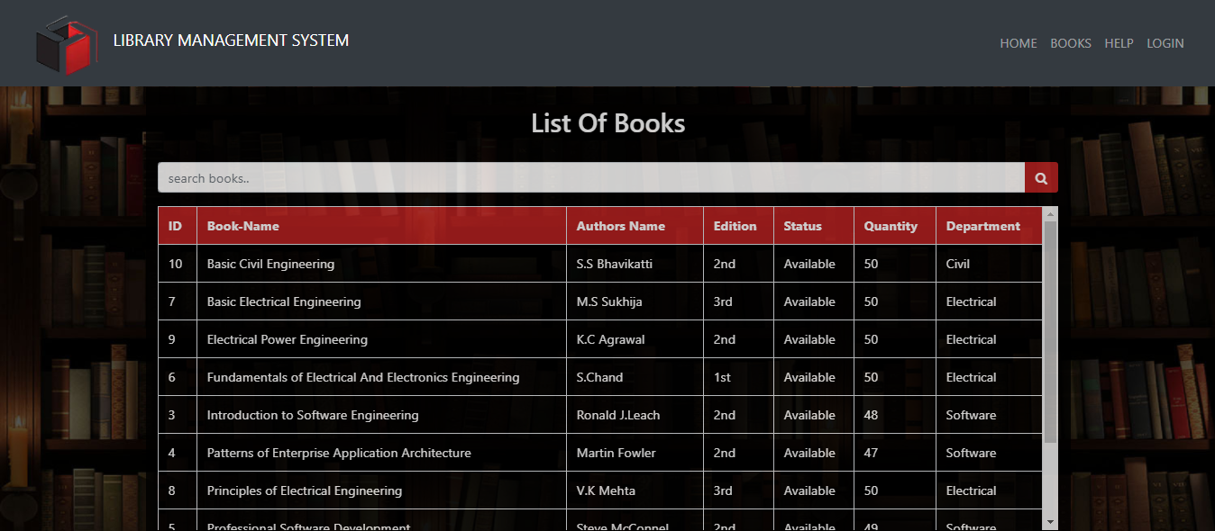
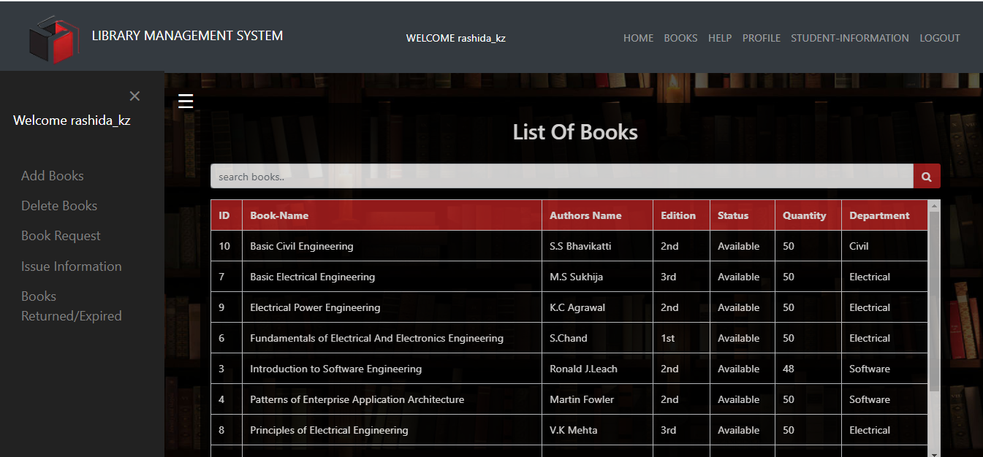
Sidebar/Searching
Without Login
With Login

Slide 9
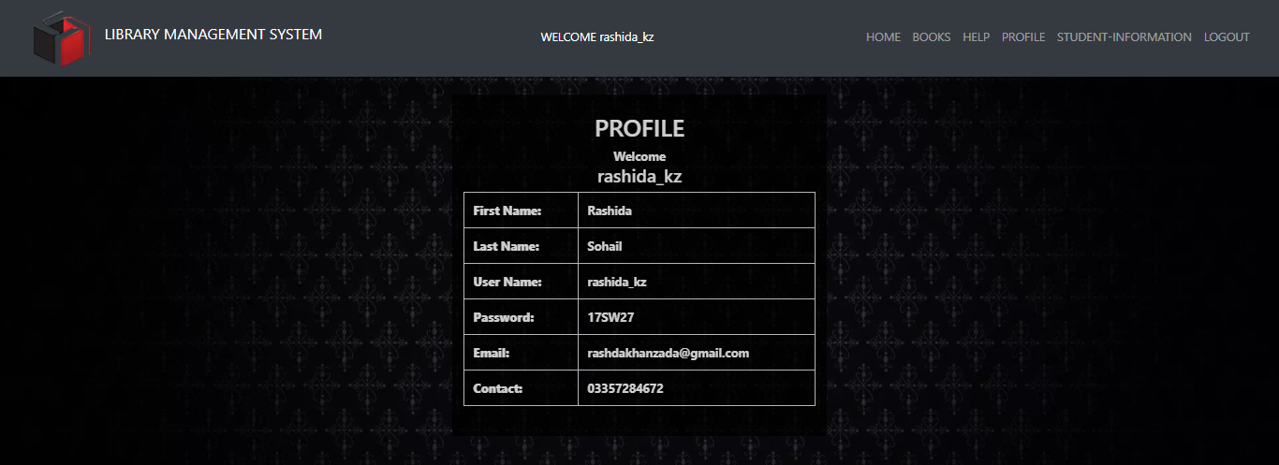
Admin Profile

Slide 10
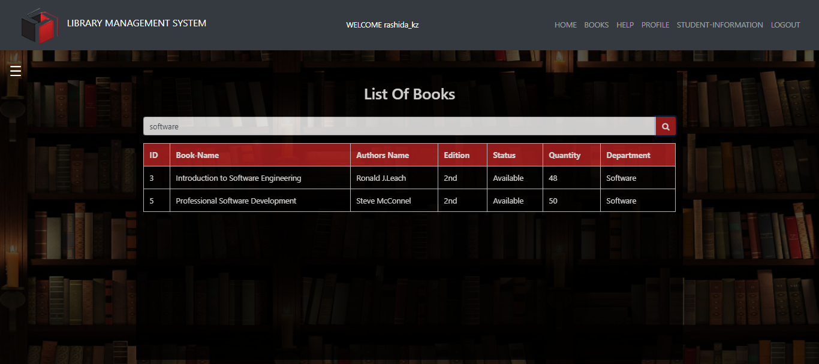
Search Book

Slide 11
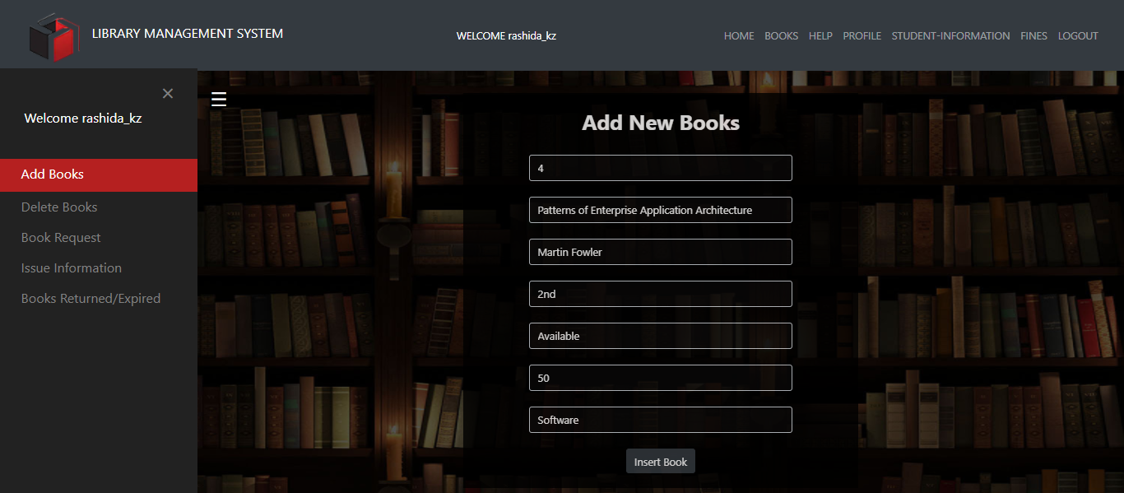
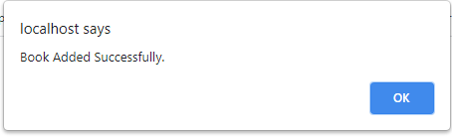
Add Books

Slide 12
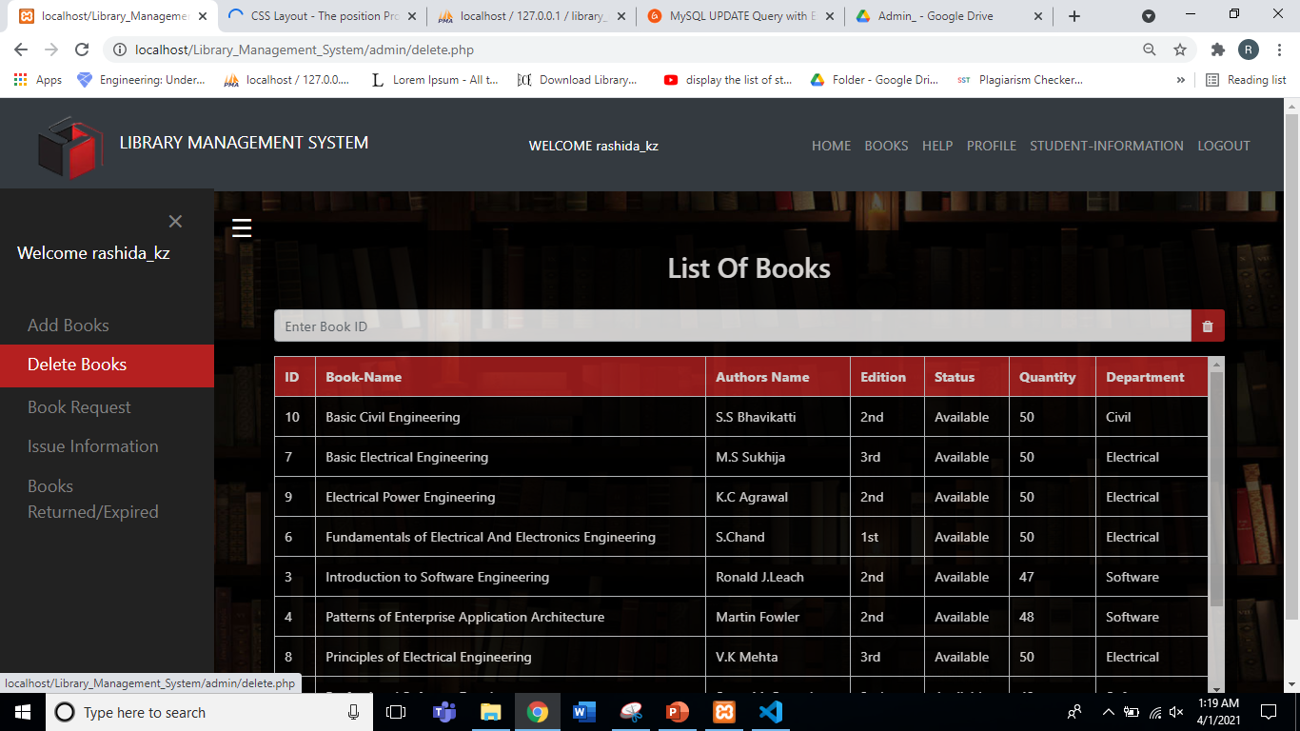
Delete Book

Slide 13
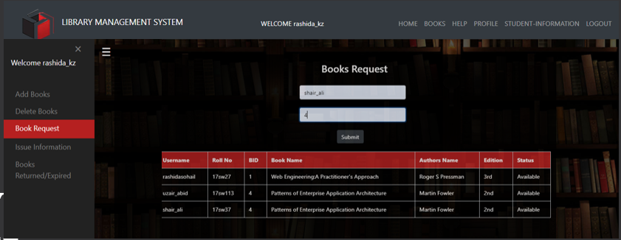
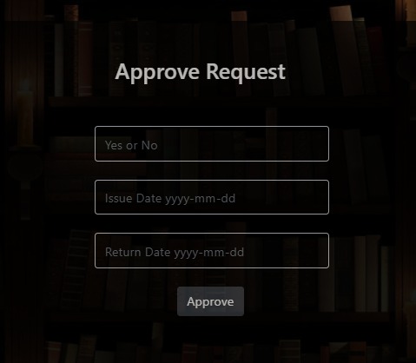
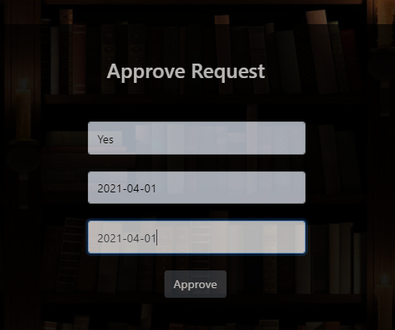
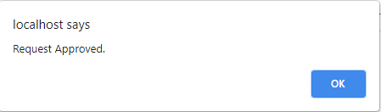
Approve
Request

Slide 14
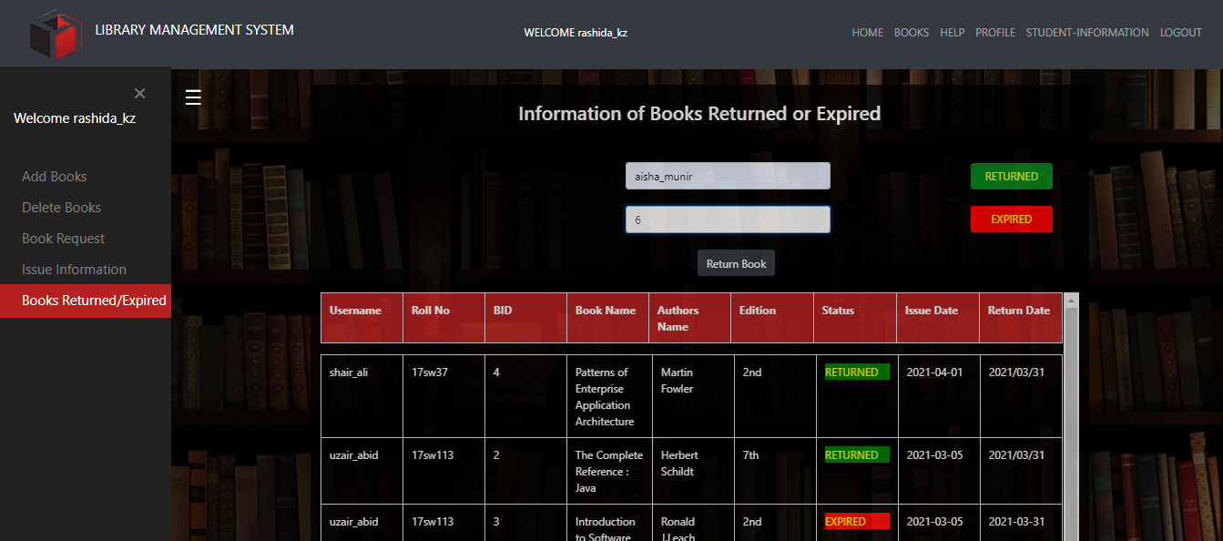
Books Returned/Expired

Slide 15
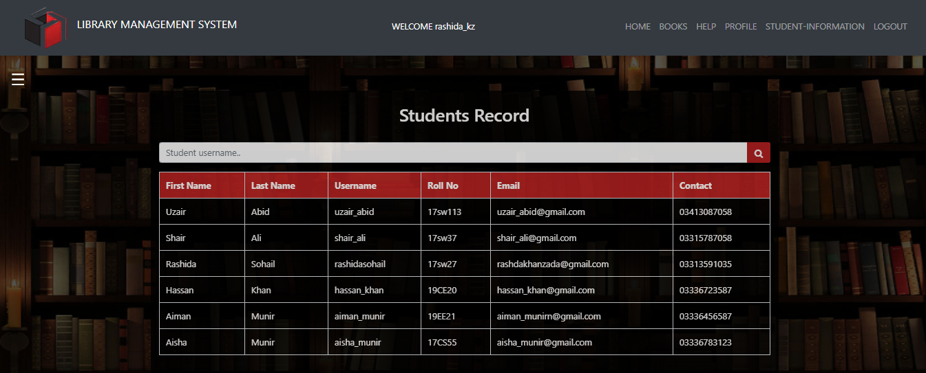
Students Record

Slide 16
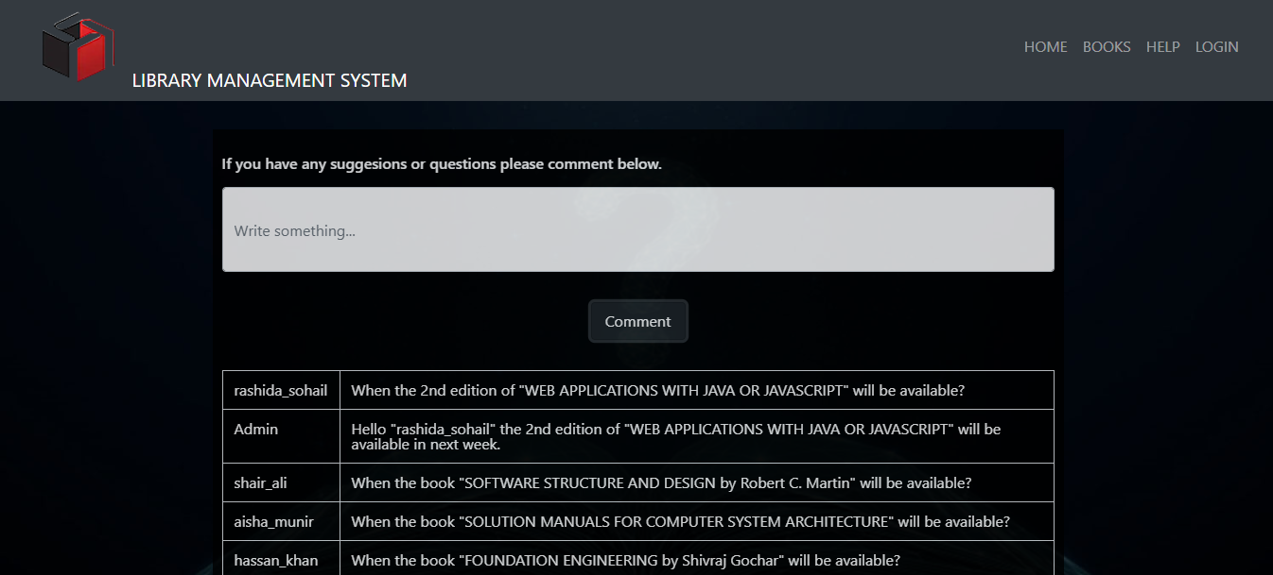
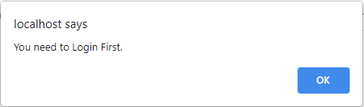
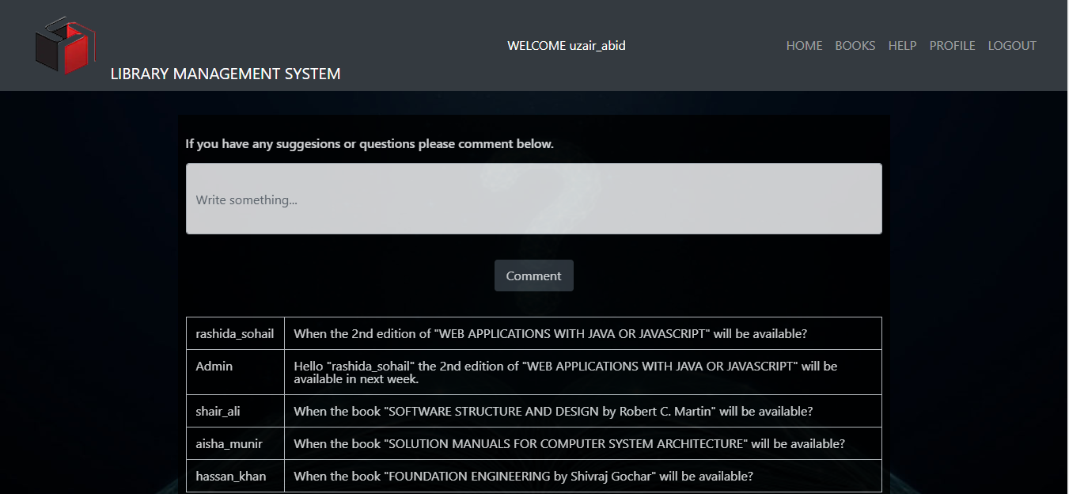
Help
Without Login
With Login

Slide 17
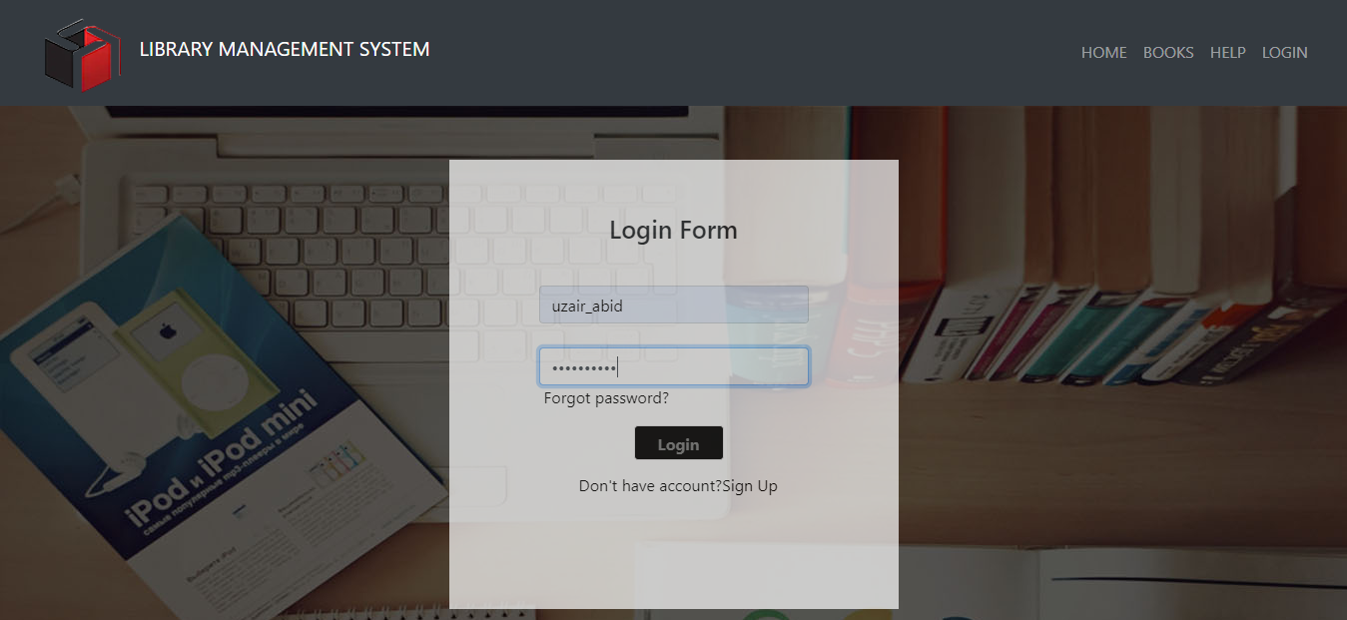
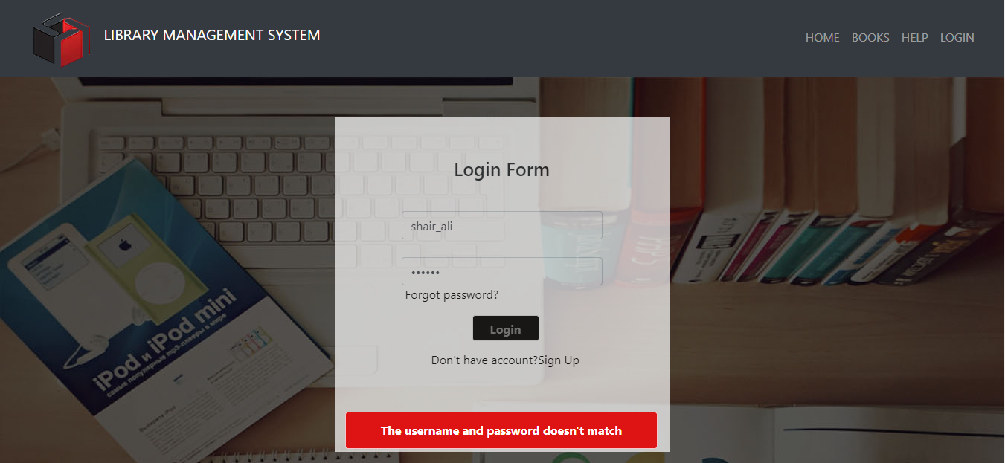
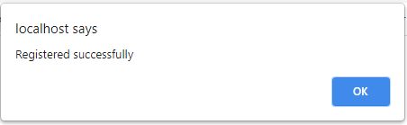
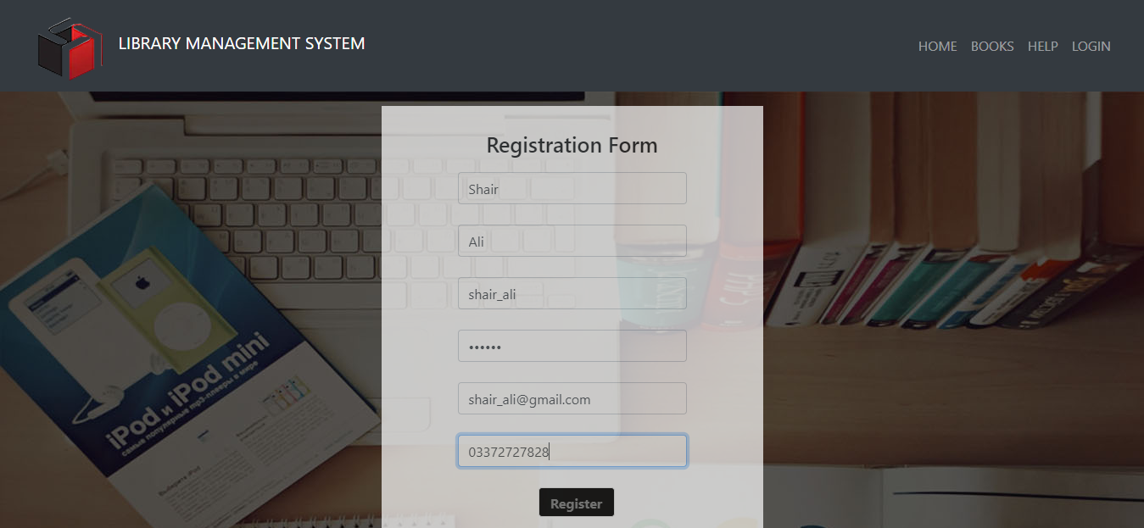
Student Login/ Sign Up
Login
Wrong username/password
Registration
Forgot Password

Slide 18
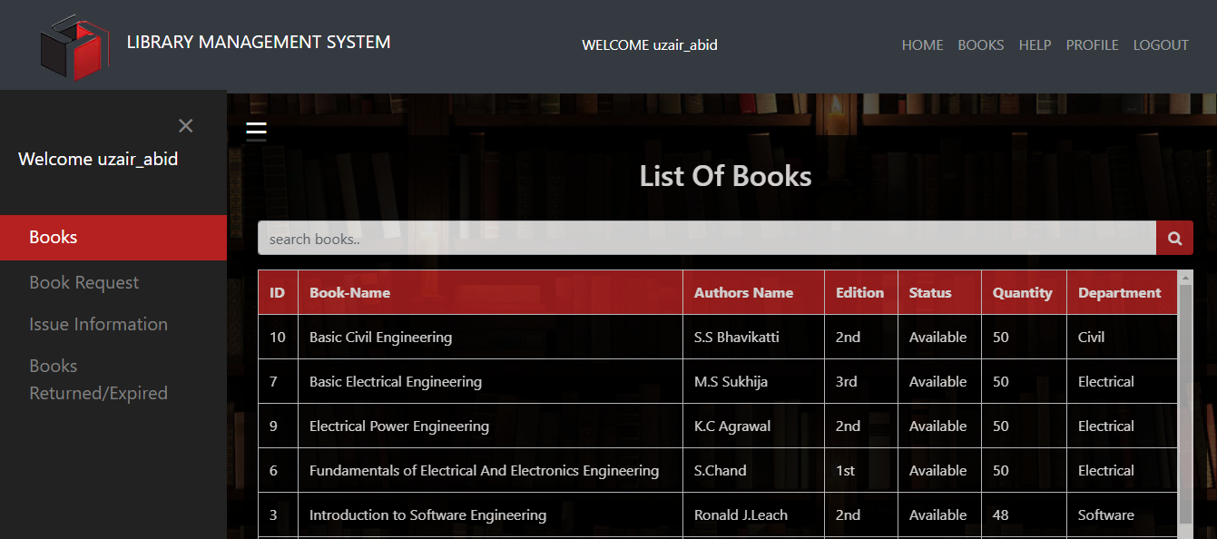
Sidebar/Searching
Without Login
With Login

Slide 19
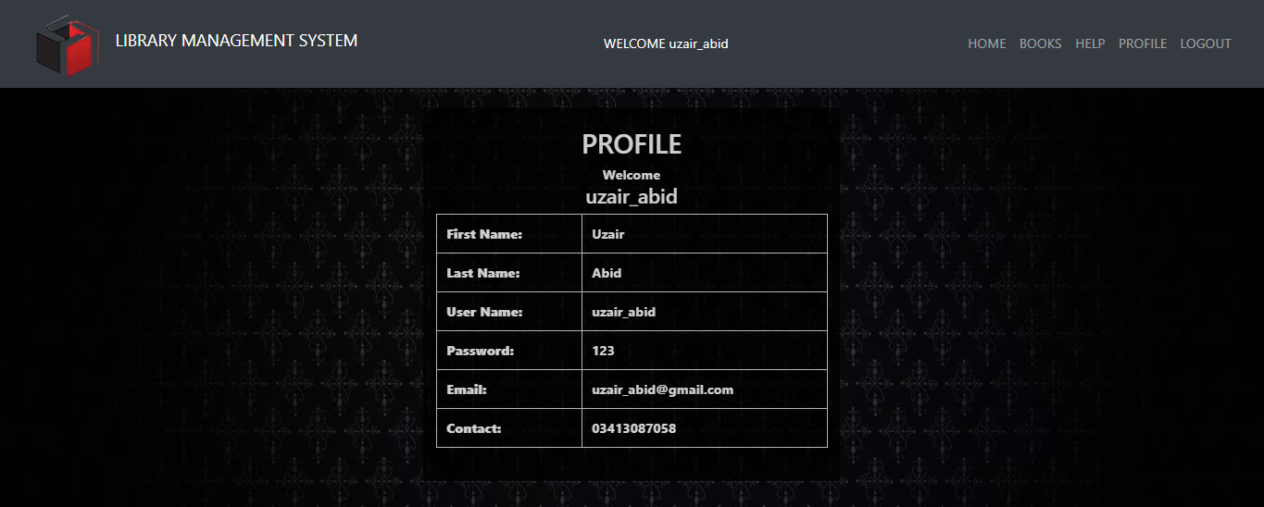
Student Profile

Slide 20
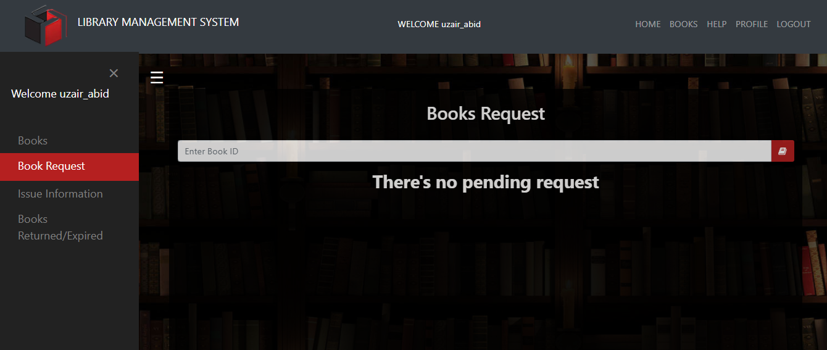
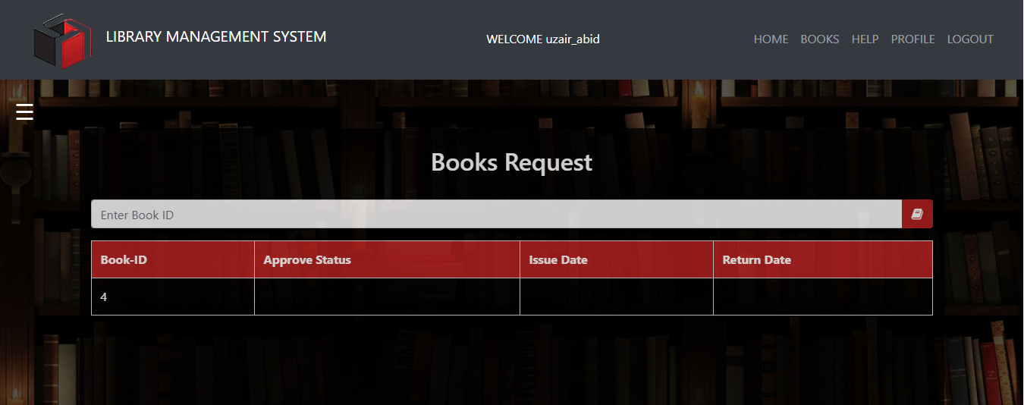
Book
Request

Slide 21
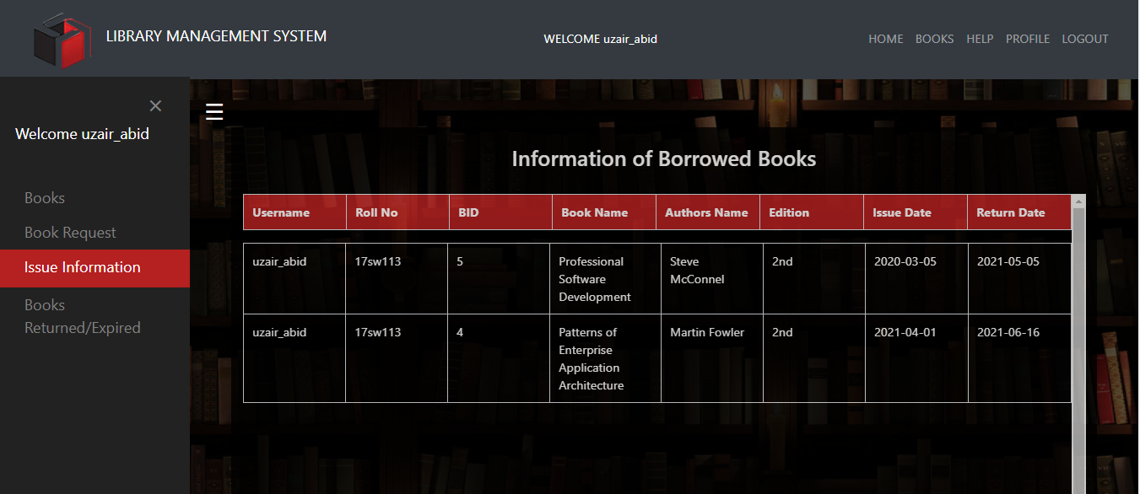
Record of Books Issued

Slide 22
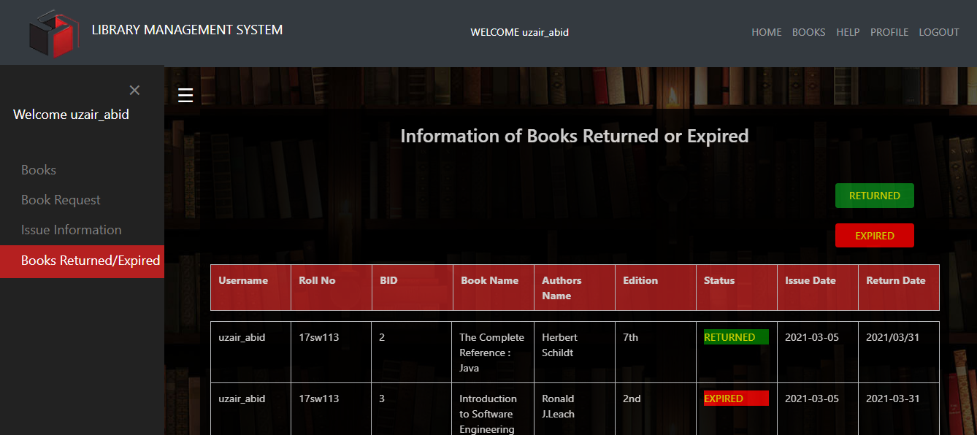
Books Returned/Expired

Slide 23
Help
Without Login
With Login

Slide 24
Thank You

